Slide 1
Week4
Suffix Arrays
KMP

Slide 2
String Matching
String matching algorithms are fundamental tools in computer science and are widely used in various applications such as text processing, data mining, information retrieval, and pattern recognition. These algorithms aim to locate occurrences of a pattern within a larger text or string.

Slide 3
Brute Force Approach to String Matching
The simplest algorithm for string matching is a brute force algorithm, where we simply try to match the first character of the pattern with the first character of the text, and if we succeed, try to match the second character, and so on; if we hit a failure point, slide the pattern over one character and try again.

Slide 4

Herding Patterns into Trie
Patterns travel one by one such that there will be multiple matching of the text with each pattern.

Slide 5

Herding patterns will solve the task by packing all the patterns onto a bus and that bus will be moved onto the text once to check for the pattern matching.

Slide 6
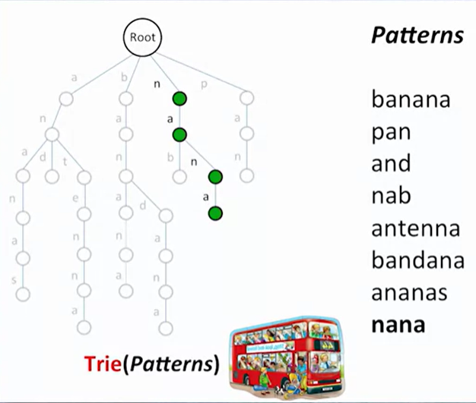

Slide 7
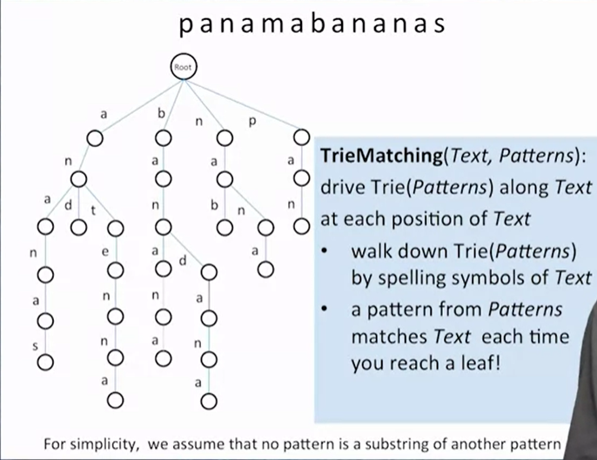

Slide 8
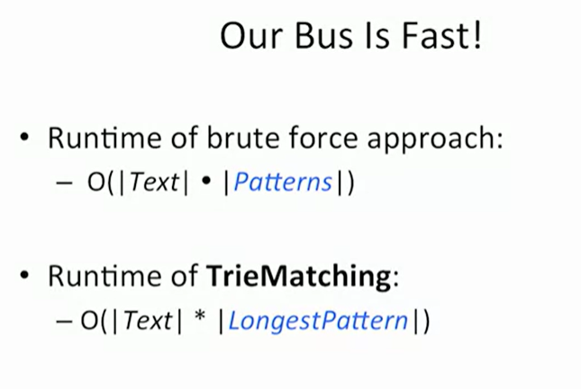

Slide 9
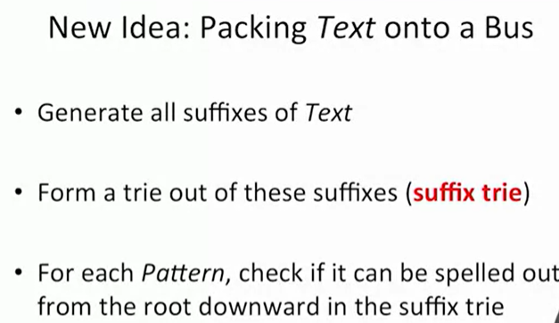
Herding Text into Suffix Trie

Slide 10
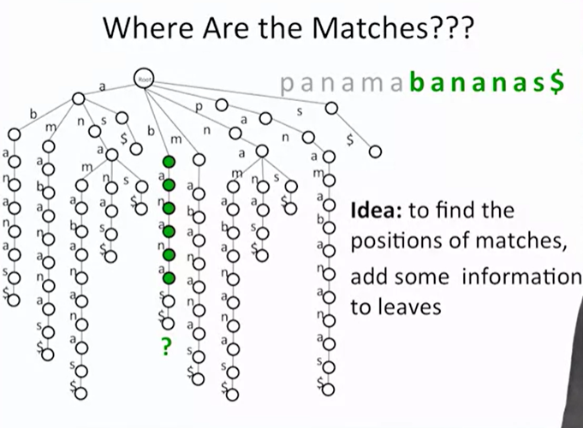

Slide 11
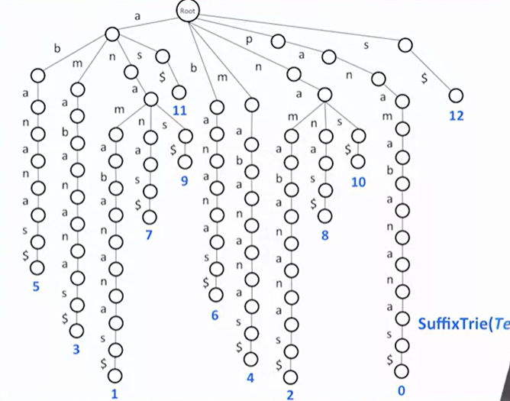

Slide 12
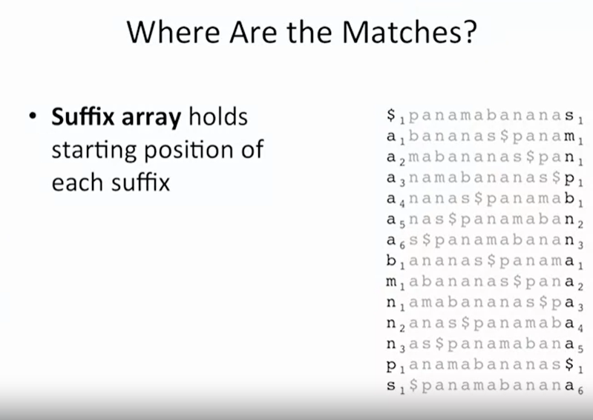
Suffix Arrays

Slide 13
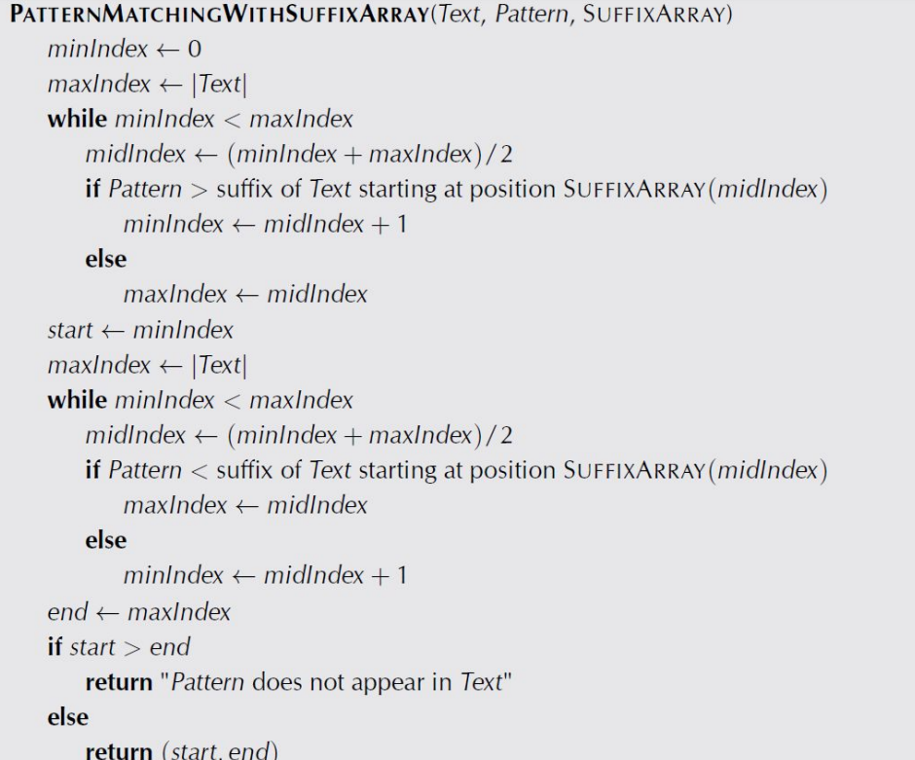

Slide 14
The Knuth-Morris-Pratt Algorithm
Knuth, Morris and Pratt proposed a linear time algorithm for the string matching problem.
A matching time of O(n) is achieved by avoiding comparisons with elements of ‘S’ that have previously been involved in comparison with some element of the pattern ‘p’ to be matched. i.e., backtracking on the string ‘S’ never occurs

Slide 15
Components of KMP algorithm
The prefix function, Π
The prefix function,Π for a pattern encapsulates knowledge about how the pattern matches against shifts of itself. This information can be used to avoid useless shifts of the pattern ‘p’. In other words, this enables avoiding backtracking on the string ‘S’.
The KMP Matcher
With string ‘S’, pattern ‘p’ and prefix function ‘Π’ as inputs, finds the occurrence of ‘p’ in ‘S’ and returns the number of shifts of ‘p’ after which occurrence is found.

Slide 16
The prefix function, Π
Following pseudocode computes the prefix fucnction, Π:
Compute-Prefix-Function (p)
1 m ← length[p] //’p’ pattern to be matched
2 Π[1] ← 0
3 k ← 0
for q ← 2 to m
do while k > 0 and p[k+1] != p[q]
6 do k ← Π[k]
If p[k+1] = p[q]
then k ← k +1
Π[q] ← k
10 return Π

Slide 17
Example: compute Π for the pattern ‘p’ below:
P
a | b | a | b | a | c | a
Initially: m = length[p] = 7
Π[1] = 0
k = 0
Step 1: q = 2, k=0
Π[2] = 0
Step 2: q = 3, k = 0,
Π[3] = 1
Step 3: q = 4, k = 1
Π[4] = 2
q | 1 | 2 | 3 | 4 | 5 | 6 | 7
p | a | b | a | b | a | c | a
Π | 0 | 0
q | 1 | 2 | 3 | 4 | 5 | 6 | 7
p | a | b | a | b | a | c | a
Π | 0 | 0 | 1
q | 1 | 2 | 3 | 4 | 5 | 6 | 7
p | a | b | a | b | a | c | A
Π | 0 | 0 | 1 | 2

Slide 18
Step 4: q = 5, k =2
Π[5] = 3
Step 5: q = 6, k = 3
Π[6] = 1
Step 6: q = 7, k = 1
Π[7] = 1
After iterating 6 times, the prefix function computation is complete: →
q | 1 | 2 | 3 | 4 | 5 | 6 | 7
p | a | b | a | b | a | c | a
Π | 0 | 0 | 1 | 2 | 3
q | 1 | 2 | 3 | 4 | 5 | 6 | 7
p | a | b | a | b | a | c | a
Π | 0 | 0 | 1 | 2 | 3 | 1
q | 1 | 2 | 3 | 4 | 5 | 6 | 7
p | a | b | a | b | a | c | a
Π | 0 | 0 | 1 | 2 | 3 | 1 | 1
q | 1 | 2 | 3 | 4 | 5 | 6 | 7
p | a | b | A | b | a | c | a
Π | 0 | 0 | 1 | 2 | 3 | 1 | 1

Slide 19
The KMP Matcher
The KMP Matcher, with pattern ‘p’, string ‘S’ and prefix function ‘Π’ as input, finds a match of p in S.
Following pseudocode computes the matching component of KMP algorithm:
KMP-Matcher(S,p)
1 n ← length[S]
2 m ← length[p]
3 Π ← Compute-Prefix-Function(p)
4 q ← 0 //number of characters matched
5 for i ← 1 to n //scan S from left to right
6 do while q > 0 and p[q+1] != S[i]
do q ← Π[q] //next character does not match
if p[q+1] = S[i]
then q ← q + 1 //next character matches
if q = m //is all of p matched?
then print “Pattern occurs with shift” i – m
q ← Π[ q] // look for the next match
Note: KMP finds every occurrence of a ‘p’ in ‘S’. That is why KMP does not terminate in step 12, rather it searches remainder of ‘S’ for any more occurrences of ‘p’.

Slide 20
Illustration: given a String ‘S’ and pattern ‘p’ as follows:
S
b | a | c | b | a | b | a | b | a | b | a | c | a | c | a
p
a | b | a | b | a | c | a
Let us execute the KMP algorithm to find whether ‘p’ occurs in ‘S’.
For ‘p’ the prefix function, Π was computed previously and is as follows:
q | 1 | 2 | 3 | 4 | 5 | 6 | 7
p | a | b | A | b | a | c | a
Π | 0 | 0 | 1 | 2 | 3 | 1 | 1

Slide 21
Initially: n = size of S = 15;
m = size of p = 7
Step 1: i = 1, q = 0
comparing p[1] with S[1]
S
b | a | c | b | a | b | a | b | a | b | a | c | a | a | b
p
a | b | a | b | a | c | a
P[1] does not match with S[1]. ‘p’ will be shifted one position to the right.
Step 2: i = 2, q = 0
comparing p[1] with S[2]
S
b | a | c | b | a | b | a | b | a | b | a | c | a | a | b
p
a | b | a | b | a | c | a
P[1] matches S[2]. Since there is a match, p is not shifted.

Slide 22
Step 3: i = 3, q = 1
Comparing p[2] with S[3]
p[2] does not match with S[3]
S
b | a | c | b | a | b | a | b | a | b | a | c | a | a | b
p
a | b | a | b | a | c | a
Backtracking on p, comparing p[1] and S[3]
Step 4: i = 4, q = 0
comparing p[1] with S[4]
p[1] does not match with S[4]
S
b | a | c | b | a | b | a | b | a | b | a | c | a | a | b
p
a | b | a | b | a | c | a
Step 5: i = 5, q = 0
comparing p[1] with S[5]
p[1] matches with S[5]
S
b | a | c | b | a | b | a | b | a | b | a | c | a | a | b
p
a | b | a | b | a | c | a

Slide 23
Step 6: i = 6, q = 1
Comparing p[2] with S[6]
p[2] matches with S[6]
S
b | a | c | b | a | b | a | b | a | b | a | c | a | a | b
p
a | b | a | b | a | c | a
Step 7: i = 7, q = 2
Comparing p[3] with S[7]
p[3] matches with S[7]
S
b | a | c | b | a | b | a | b | a | b | a | c | a | a | b
p
a | b | a | b | a | c | a
Step 8: i = 8, q = 3
Comparing p[4] with S[8]
p[4] matches with S[8]
S
b | a | c | b | a | b | a | b | a | b | a | c | a | a | b
p
a | b | a | b | a | c | a

Slide 24
Step 9: i = 9, q = 4
Comparing p[5] with S[9]
p[5] matches with S[9]
S
b | a | c | b | a | b | a | b | a | b | a | c | a | a | b
p
a | b | a | b | a | c | a
Step 10: i = 10, q = 5
Comparing p[6] with S[10]
p[6] doesn’t match with S[10]
S
b | a | c | b | a | b | a | b | a | b | a | c | a | a | b
p
a | b | a | b | a | c | a
Backtracking on p, comparing p[4] with S[10] because after mismatch q = Π[5] = 3
Step 11: i = 11, q = 4
Comparing p[5] with S[11]
p[5] matches with S[11]
b | a | c | b | a | b | a | b | a | b | a | c | a | a | b
S
p
a | b | a | b | a | c | a

Slide 25
Step 12: i = 12, q = 5
Comparing p[6] with S[12]
p[6] matches with S[12]
S
b | a | c | b | a | b | a | b | a | b | a | c | a | a | b
p
a | b | a | b | a | c | a
Step 13: i = 13, q = 6
Comparing p[7] with S[13]
p[7] matches with S[13]
S
b | a | c | b | a | b | a | b | a | b | a | c | a | a | b
p
a | b | a | b | a | c | a
Pattern ‘p’ has been found to completely occur in string ‘S’. The total number of shifts
that took place for the match to be found are: i – m = 13 – 7 = 6 shifts.

Slide 26
Running - time analysis
KMP Matcher
1 n ← length[S]
2 m ← length[p]
3 Π ← Compute-Prefix-Function(p)
4 q ← 0
5 for i ← 1 to n
6 do while q > 0 and p[q+1] != S[i]
do q ← Π[q]
if p[q+1] = S[i]
then q ← q + 1
if q = m
then print “Pattern occurs with shift” i – m
q ← Π[ q]
The for loop beginning in step 5 runs ‘n’ times, i.e., as long as the length of the string ‘S’. Since step 1 to step 4 take constant time, the running time is dominated by this for loop. Thus running time of matching function is Θ(n).
Compute-Prefix-Function (Π)
1 m ← length[p] //’p’ pattern to be matched
2 Π[1] ← 0
3 k ← 0
for q ← 2 to m
do while k > 0 and p[k+1] != p[q]
6 do k ← Π[k]
If p[k+1] = p[q]
then k ← k +1
Π[q] ← k
return Π
In the above pseudocode for computing the prefix function, the for loop from step 4 to step 10 runs ‘m’ times. Step 1 to step 3 take constant time. Hence the running time of compute prefix function is Θ(m).

Slide 27
MCQs
What is the Prefix function values for Pattern
“AAAA”
a)0123
b)0012
c)0122
d)0112
Notes:
a

Slide 28
MCQs
What is the Prefix function values for Pattern
“ABCDE”
a)00000
b)00120
c)01220
d)01120
Notes:
a

Slide 29
MCQs
What is the Prefix function values for Pattern
“AABAACAABAA”
a) 01012012334
b)01012012345
c)01012012344
d)01112012345
Notes:
B

Slide 30
MCQs
What is the Prefix function values for Pattern
“AAACAAAAAC”
a)0121123334
b)0120123444
c)0120123344
d)0120123334
Notes:
D

Slide 31
MCQ’s
What is the runtime complexity of Brute force approach of pattern matching?
O(|Text|)
O(|Text||Patterns|)
O(|Patterns|)
None of the above
Notes:
b

Slide 32
MCQ’s
What is the runtime complexity of Trie Matching Approach of pattern matching?
O(|Text|)
O(|Text||Longest Pattern|)
O(|Longest Pattern|)
None of the above
Notes:
b

Slide 33
MCQ’s
Herding patterns involves the packing of packets in the form of
Tree
Bus
Both
None of the above
Notes:
b

Slide 34
MCQ’s
What is the time complexity of searching all occurrences of n patterns p1​,p2​,…,pn​ in text T of length ∣T∣ if all patterns have length at most L and the sum of their lengths is at most S?
O(L)
O(∣T∣S)
O(S)
O(∣T∣L)
Lovely Professional University Admin | Coursera
Notes:
d

Slide 35
Thank You !!!

